Slide 1
Starting to Crawl

Slide 2
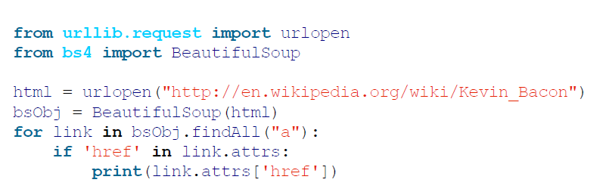
Traversing a Single Domain
Python script that retrieves an arbitrary Wikipedia page and produces a list of links on that page:

Slide 3
Selective retrieval
retrieve only the desired article links:
They reside within the div with the id set to bodyContent
The URLs do not contain semicolons
The URLs begin with /wiki/

Slide 4
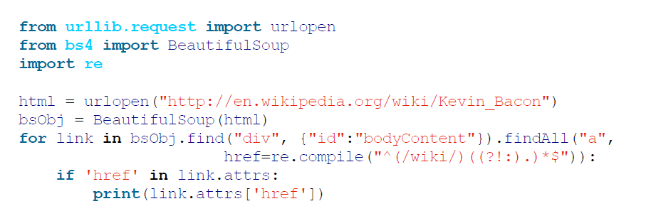
Retrieving Articles Only

Slide 5
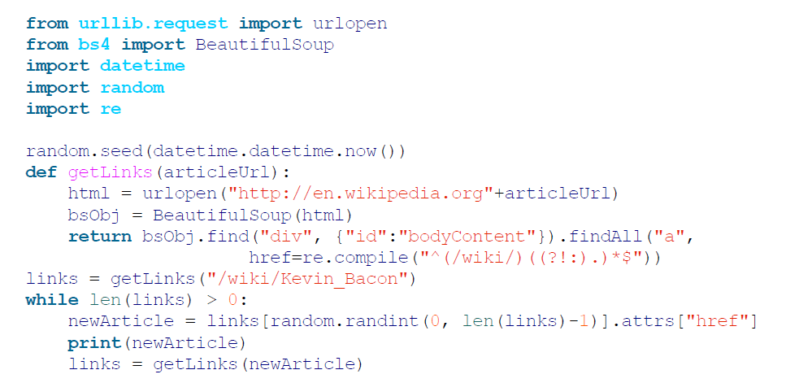
Generalize:

Slide 6
Exception handling
Handle Your Exceptions:
What if Wikipedia changed the name of the bodyContent tag

Slide 7
Crawling an Entire Site
THE DARK AND DEEP WEBS
deep Web is simply any part of the Web that’s not part of the surface Web
deep Web almost certainly makes up about 90% of the Internet
dark Web, also known as the Darknet or dark Internet, is run over the existing network infrastructure but uses a Tor client with an application protocol that runs on top of HTTP, providing a secure channel to exchange information.

Slide 8
Crawling an Entire Site
general approach to an exhaustive site crawl is to start with a top-level page (such as the home page), and search for a list of all internal links on that page.
Every one of those links is then crawled, and additional lists of links are found on each one of them, triggering another round of crawling

Slide 9
Crawling an Entire Site
If every page has 10 internal links, and a website is five pages deep (a fairly typical depth for a medium-size website), then the number of pages you need to crawl is 100,000 pages
vast majority of internal links are duplicates

Slide 10
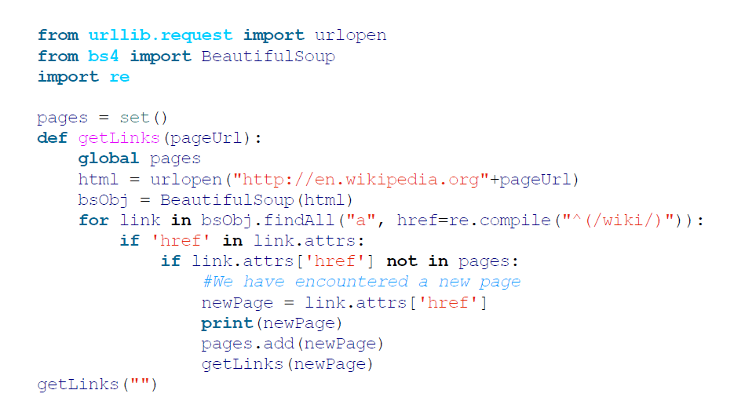
avoid crawling the same page twice

Slide 11
Implementation Warning
A Warning Regarding Recursion:
Python has a default recursion limit of 1,000

Slide 12
Collecting Data Across an Entire Site
For Wikipedia pages both articles and non-article pages such as the privacy policy page:
All titles (on all pages, regardless of their status as an article page, an edit history page, or any other page) have titles under h1→span tags, and these are the only h1 tags on the page.

Slide 13
Collecting Data Across an Entire Site
all body text lives under the div#bodyContent tag.
However, if we want to get more specific and access just the first paragraph of text, we might be better off using div#mw-content-text →p (selecting the first paragraph tag only).
This is true for all content pages except file pages (for example: http://bit.ly/1KwqJtE), which do not have sections of content text.

Slide 14
Collecting Data Across an Entire Site
Edit links occur only on article pages. If they occur, they will be found in the li#ca-edit tag, under li#ca-edit → span → a.

Slide 15
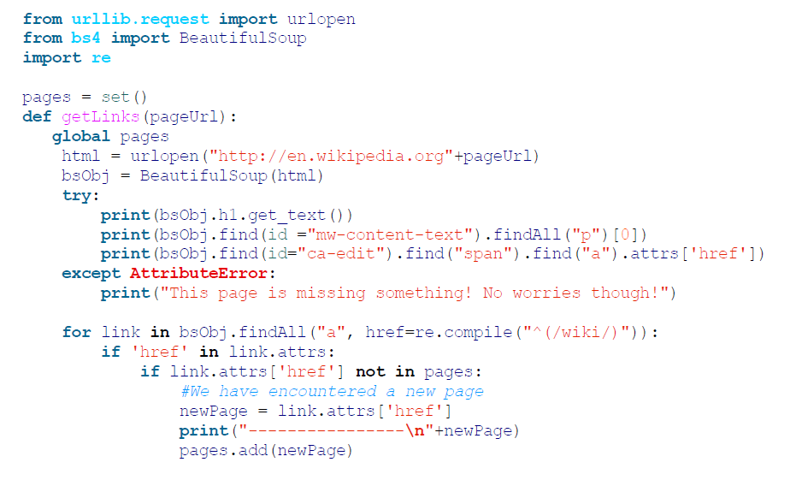
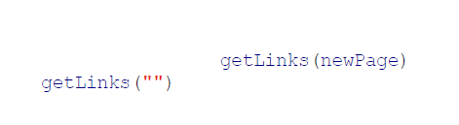
combination crawler/data gathering (or, at least, data printing) program

Slide 16
Crawling Across the Internet
Explore….cautiously

Slide 17
Ex.1
Given a root URL, e.g., "https://en.wikipedia.org/wiki/Web_mining", Design a simple crawler to return all pages that contains a string “crawler" from this site.

Slide 18
Ex.2
Write a web crawler program which takes as input a url, a search word and maximum number of pages to be searched and returns as output all the web pages it searched till it found the search word on a web page or return failure.

Slide 19
Ex.3
Implement breadth-first-search and depth-first-search crawlers for Ex. 2.

Slide 20
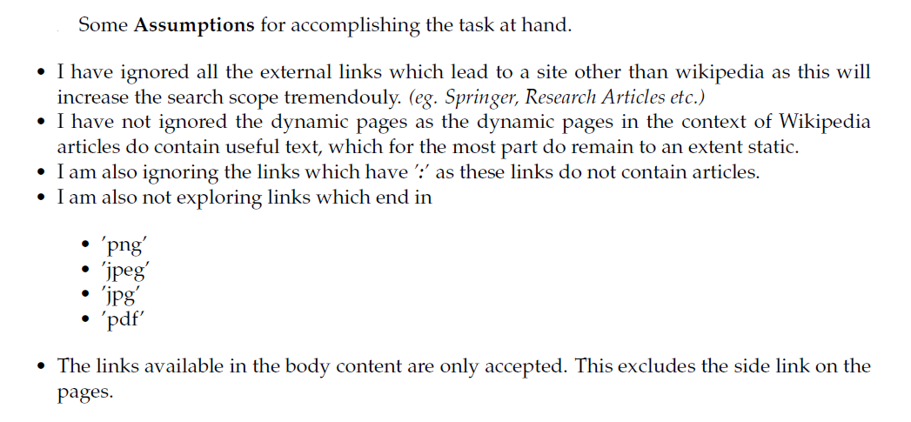
Example of assumptions

Slide 21
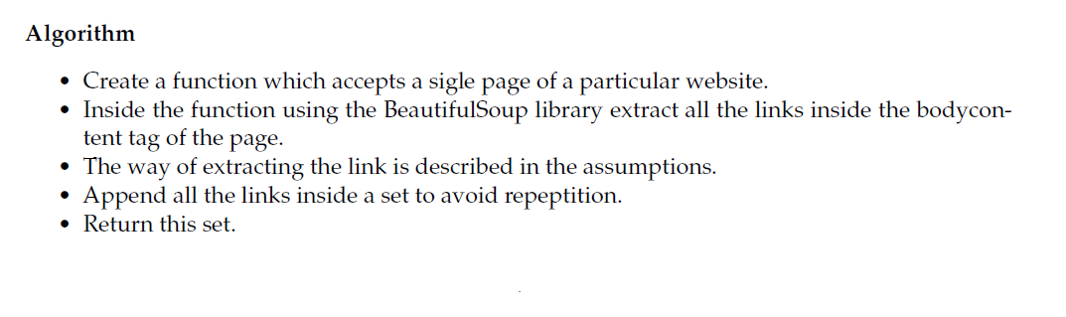
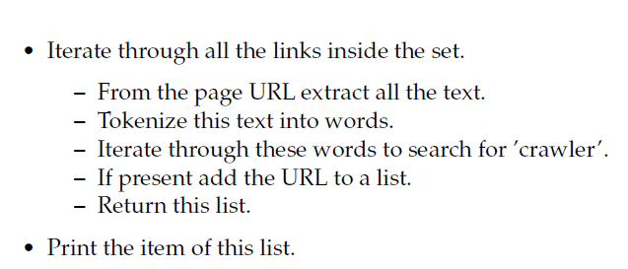
Example algorithm

